Slide 1

Software Engineering
Gruppo 9 – Drawing App
Lorenzo Mignone - 0622701866
Artemis Ostadimitris - 0622701874
Gaetano Parolise - 0622701919
Davide Parente - 0622701859

Slide 2
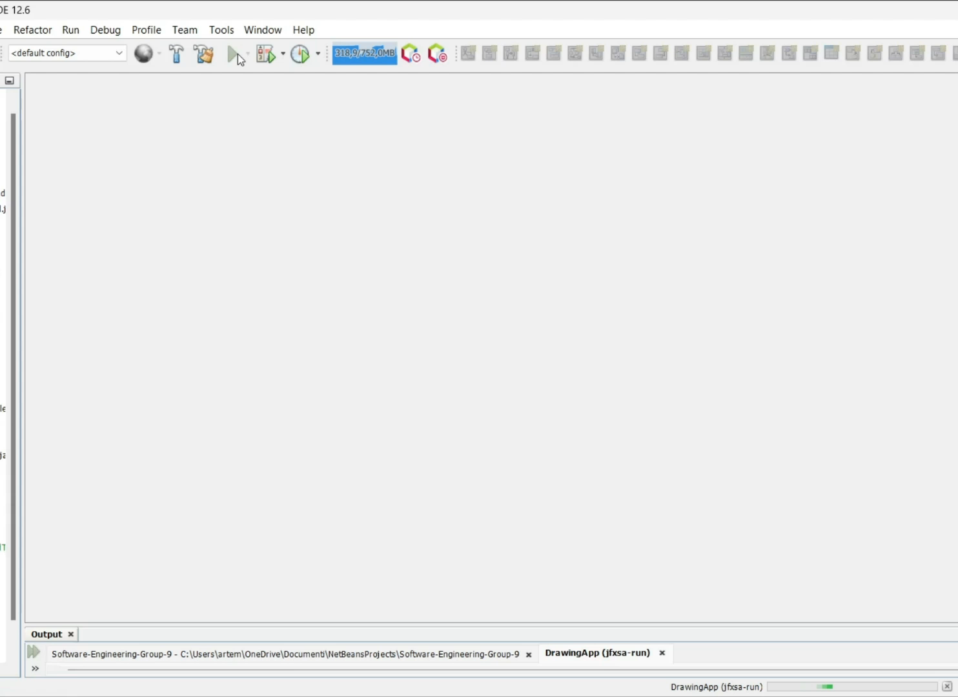
Sprint 2 - Release

Slide 3

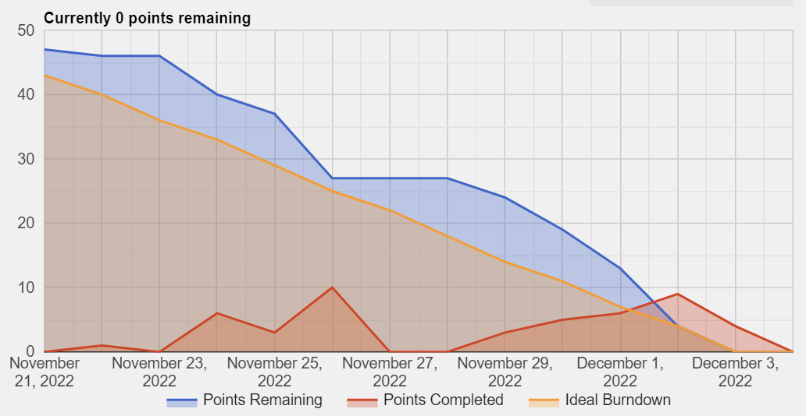

Sprint Review
Team velocity
Estimated a priori velocity: 27 SP
Estimated retrospectively velocity: 27 SP
Multiple consecutive undo operations cannot be performed
Problems detected

Slide 4
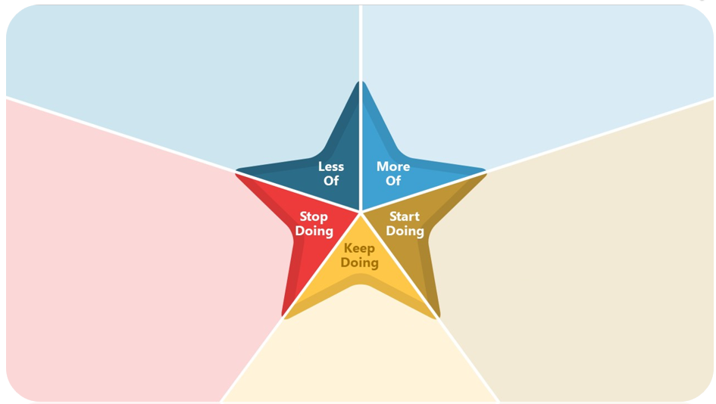
Retrospective
Comment out code
Nothing
Remember to update your Trello burndown chart
Remember to check out of DoD’s checklist
Don’t respect the convention
Continue doing meetings
Continue doing code review by all members
Raise issues during daily meetings

Slide 5
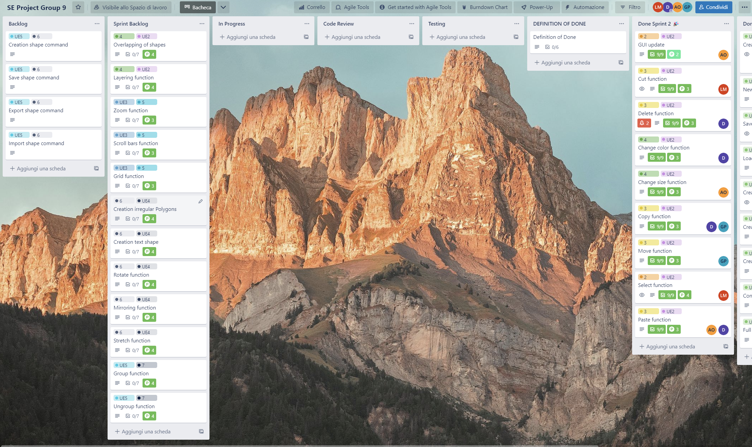
Second Sprint Backlog

